Slide 1




Team 2
Excel Tools: Pivot Table and Conditional Formatting
By
Aboderin Oluwafolajinmi
Omitogun Emmanuel
Arogundade Victory
Emmanuel Esther O.
Folajimi Awotunde
Maikano Jeremiah

Slide 2

Key Content
Introduction to Pivot Tables
What Pivot Table is?
Advanced Features of Pivot Tables
Preparing Your Pivot Table
Creating Your first Pivot Table
Drag and drop fields
Real-World Examples
Introduction to Conditional formatting
Types of Conditional formatting
Integration of Pivot Tables & Conditional Formatting
Meet The Team

Slide 3


Introduction to Pivot Tables
To Pivot = Turn/View from a different perspective.
In Excel, a Pivot table is a summarization tool that allows us to see or summarize large datasets for easy and quick analysis.

Slide 4


Team 2
The Pivot Table has these key components: Rows Area, Columns Area, Values Area, Filters Area, Calculated Fields, Groupings and Slicers.
What Pivot Table is?
An Interactive Tool
Data Transformation
Dynamic Insights

Slide 5



Team 2
Advanced Features of Pivot Table
Calculated Fields
Creates custom formulas that updates with data changes
Data Grouping
Combines items into meaningful categories for clarity.
Slicer Integration and Pivot charts
Employ visual filters for better data exploration and insights.
Conditional Formatting
Apply automatic formatting for immediate visual data analysis.

Slide 6



Team 2
Preparing Your Data for Pivot Tables
TABULAR FORMAT
CONSISTENT DATA TYPES
CONVERT TO EXCEL TABLE

Slide 7

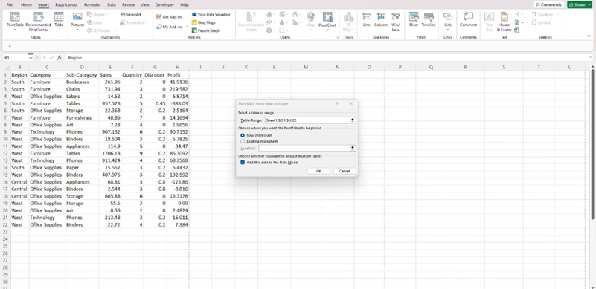



Team 2
Creating Your First Pivot Table
Select any cell within your organized data or Excel Table.
Navigate to the Insert tab in the Excel ribbon.
Click on the PivotTable button.
Choose whether to place the PivotTable on a New Worksheet or an Existing Worksheet.
Click OK to generate a blank PivotTable and open the PivotTable Fields pane, ready for customization.

Slide 8
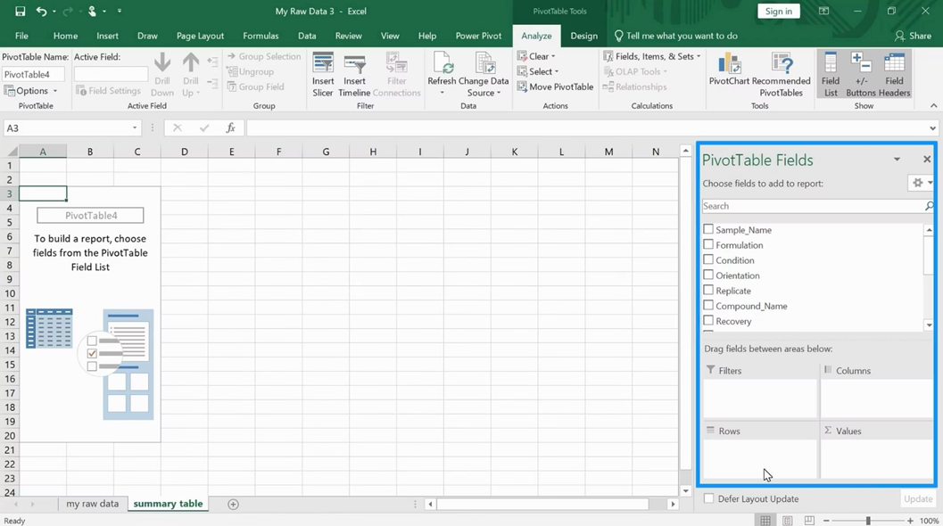
Team 2
Building Your Pivot Table: Drag & Drop Fields
The magic of Pivot Tables lies in their intuitive drag-and-drop functionality, allowing you to sculpt your data report with ease.
Field Areas
Drag fields to Rows to display unique entries down the left side.
Drag fields to Columns to display unique entries across the top.
Drag fields to Values to perform calculations (e.g., sum, count) on numerical data.
Drag fields to Filters to narrow down the data displayed in the PivotTable.
For example, drag "Product" to Rows, "Amount" to Values, and "Country" to Filters. Instantly see totals, counts, averages, or other summaries based on your selections.

Slide 9
Team 2
Real-World Example: Sales Data Analysis
Let’s consider a scenario where you have sales data and want to extract key insights quickly.
Top-Selling Products
Monthly Sales Trends
Quickly identify which products are performing best in specific countries by applying filters to your product and geographical fields.
Pivot date fields into months or quarters to analyze sales trends over time, spotting seasonality or growth patterns.

Slide 10
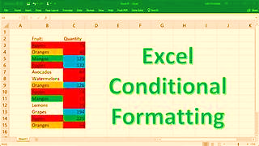
Introduction to Conditional Formatting
Conditional formatting is a technique that allows you to modify cell formatting based on specific conditions.
Use Cases
Budget tracking
Sales Analysis
Project Management
Performance Evaluation

Slide 11
Team 2
Types of Conditional Formatting.
HIGHLIGHTS RULES
COLOR SCALES
ICON SETS
TOP/BOTTOM RULES
DATA BARS

Slide 12
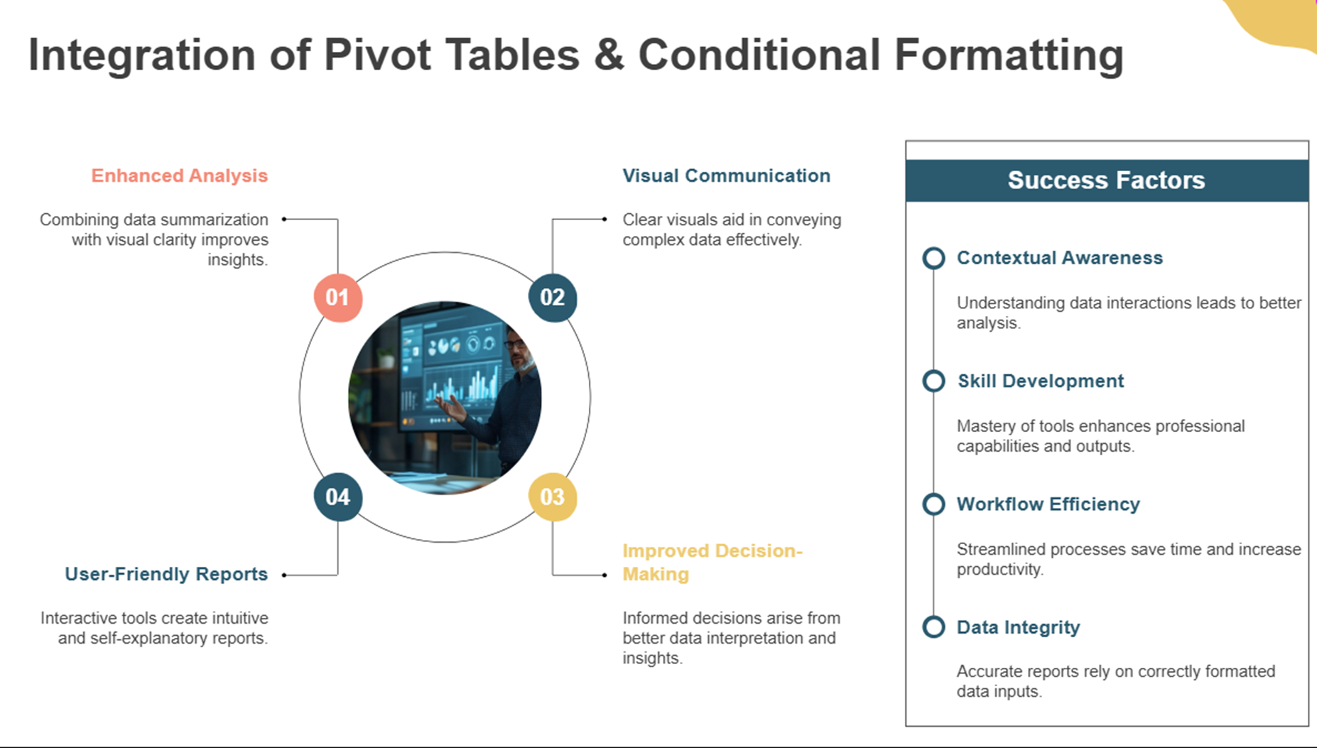
Team 2

Slide 13









Team 2
Meet Our Team
ABODERIN OLUWAFOLAJIMI
VICTORY AROGUNDADE
OMITOGUN EMMANUEL
AWOTUNDE FOLAJIMI
ESTHER O. EMMANUEL
JEREMIAH MAIKANO

Slide 14

Team 2
Thank
You

